Slide 1

MongoDB
YILMAZ Mustafa
ROQUERO Pedro

Slide 2
Table of Contents
Introduction
Implementation
Consistency model
Advantages
Connections
User stories
Demo

Slide 3

Introduction
MongoDB
Document oriented
Format Bson
Basic features:
Ad-hoc queries for optimized ,RT analytics
Indexing for better query executions
Replication for data availability and stability
Sharding
Load balancing

Slide 4
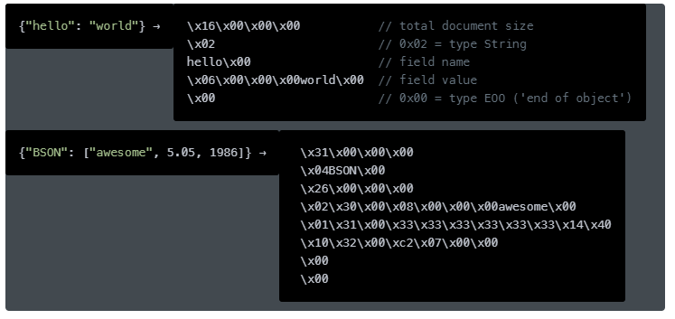
JSON VS BSON
JSON’s readable format is far from space-efficient, another database concern
JSON only supports a limited number of basic data types
JSON is a text-based format, and text parsing is very slow

Slide 5
Implementation
MongoDB website : Data | Atlas: MongoDB Atlas
Drivers supported : C, C++, C#, .Net, Go, Java, Node.js, Perl, PHP, Python, Motor, Ruby, Scala, Swift, Mongoid.

Slide 6
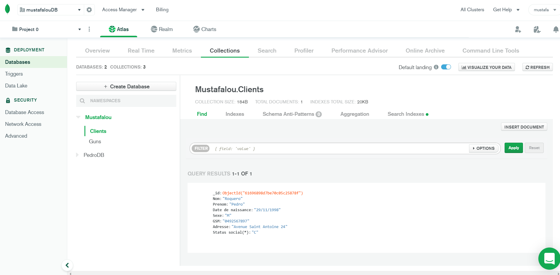
MongoDB Website

Slide 7
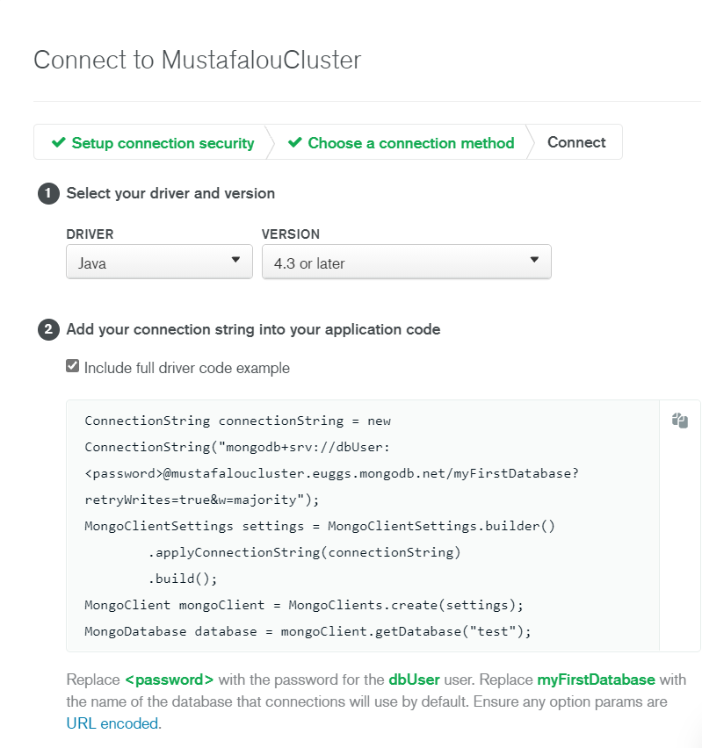
Example of driver’s connections

Slide 8
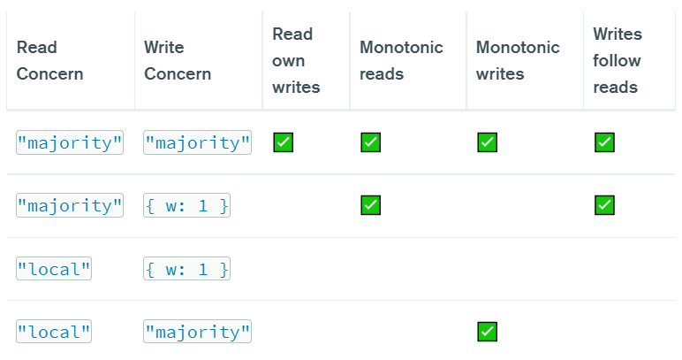
Consistency Model
Causal consistency

Slide 9
Advantages
Fast and easy to work with
Able to work with a lot of languages
No need to have the same columns/data for each document
Stocked in a Bson format
Multiple people can update the database at the same time
Allows map reduce

Slide 10
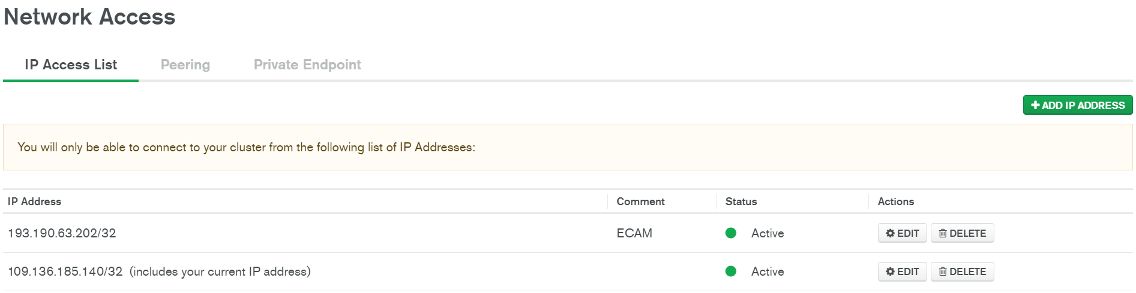
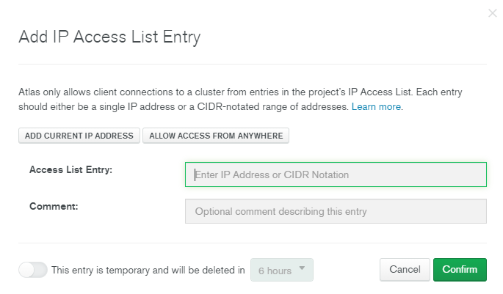
Connections
Two steps to follow:
Add IP address to the cluster:

Slide 11
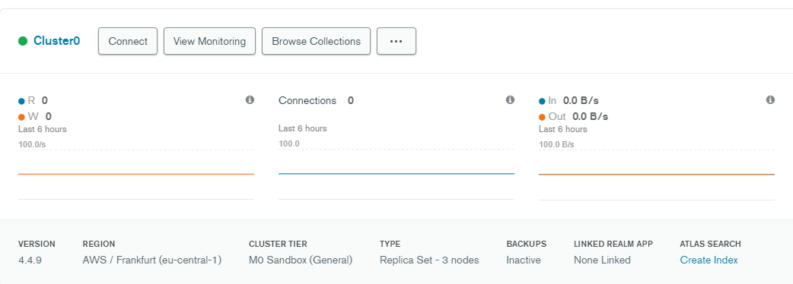
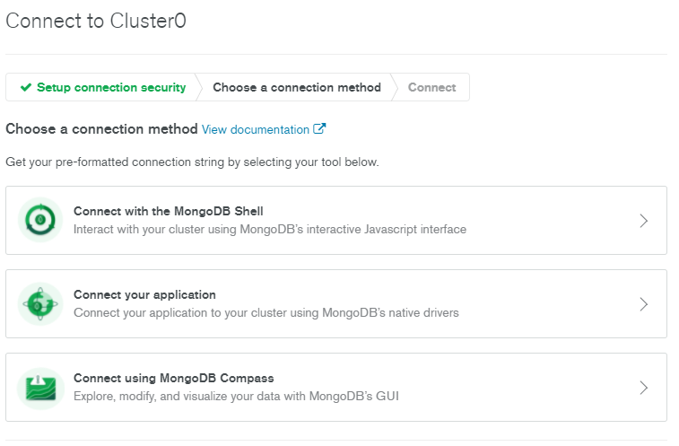
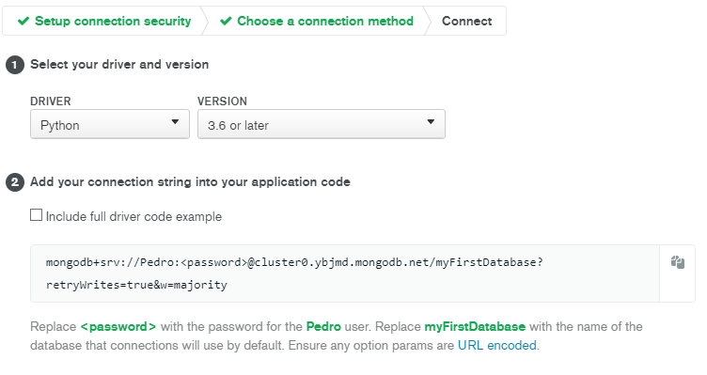
Connections
Use generated link to connect your application:

Slide 12
User stories
As a secretary, I want to be able to add a new customer in order to have their data on the database.
As a secretary, I want to be able to search a customer in order to see all the information of the costumer.
As a secretary, I want to be able to change customer information in order to update the database.

Slide 13
DEMO

Slide 14
Bibliography
MongoDB Atlas: Cloud Document Database | MongoDB
Tutorial — PyMongo 3.12.1 documentation
What is MongoDB? Introduction, Architecture, Features & Example (guru99.com)
Top 5 Features of MongoDB | MongoDB

